Slide 1

Final PRESENTATION SPR600
Ananthu Krishna Vadakkeppatt
154290217
SPR600
Individual Presentation
Demo Link: https://www.youtube.com/watch?v=RO6cuWu9bDA

Slide 2

Brief Incident Description
The Optus Data Breach 2022 occurred due to a poorly configured and unprotected API that was publically exposed.
Moreover, it was found that the API did not even have any user authentication mechanisms built on to it .
Several pieces of sensitive information such as Names, Date of Births, Home Addresses, Phone numbers and Driving License numbers were exfiltrated.
The absence of unique customer identifiers was another vulnerability, that allowed the attacker to write a script that increments by one.

Slide 3
Incident Simulation Description
Discovering the hosts within the network.
Conducting Nmap Scans with the hosts to identify ports and services.
Using the dirb we will conduct directory traversal attacks.
Access the endpoint using the attacker machine.
Run a script that exfiltrates the sensitive information from the API.

Slide 4
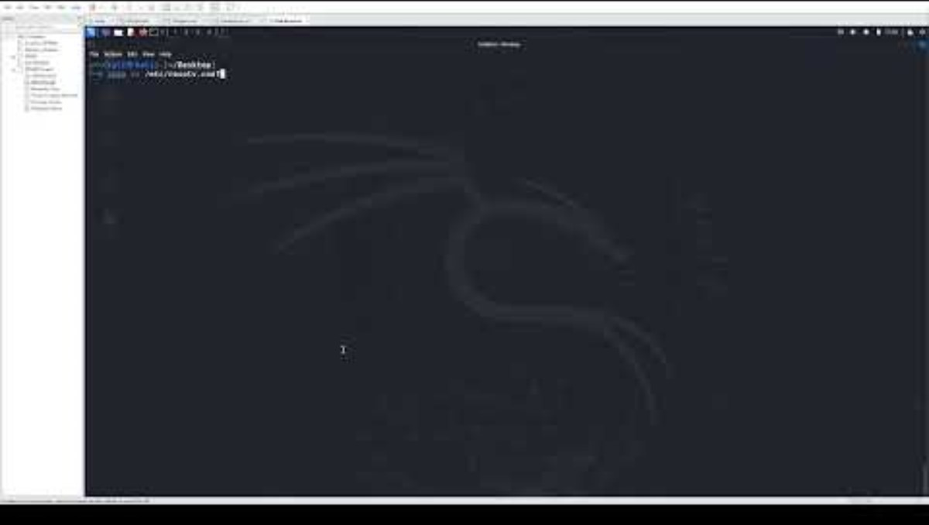
Incident Simulation Demo

Slide 5
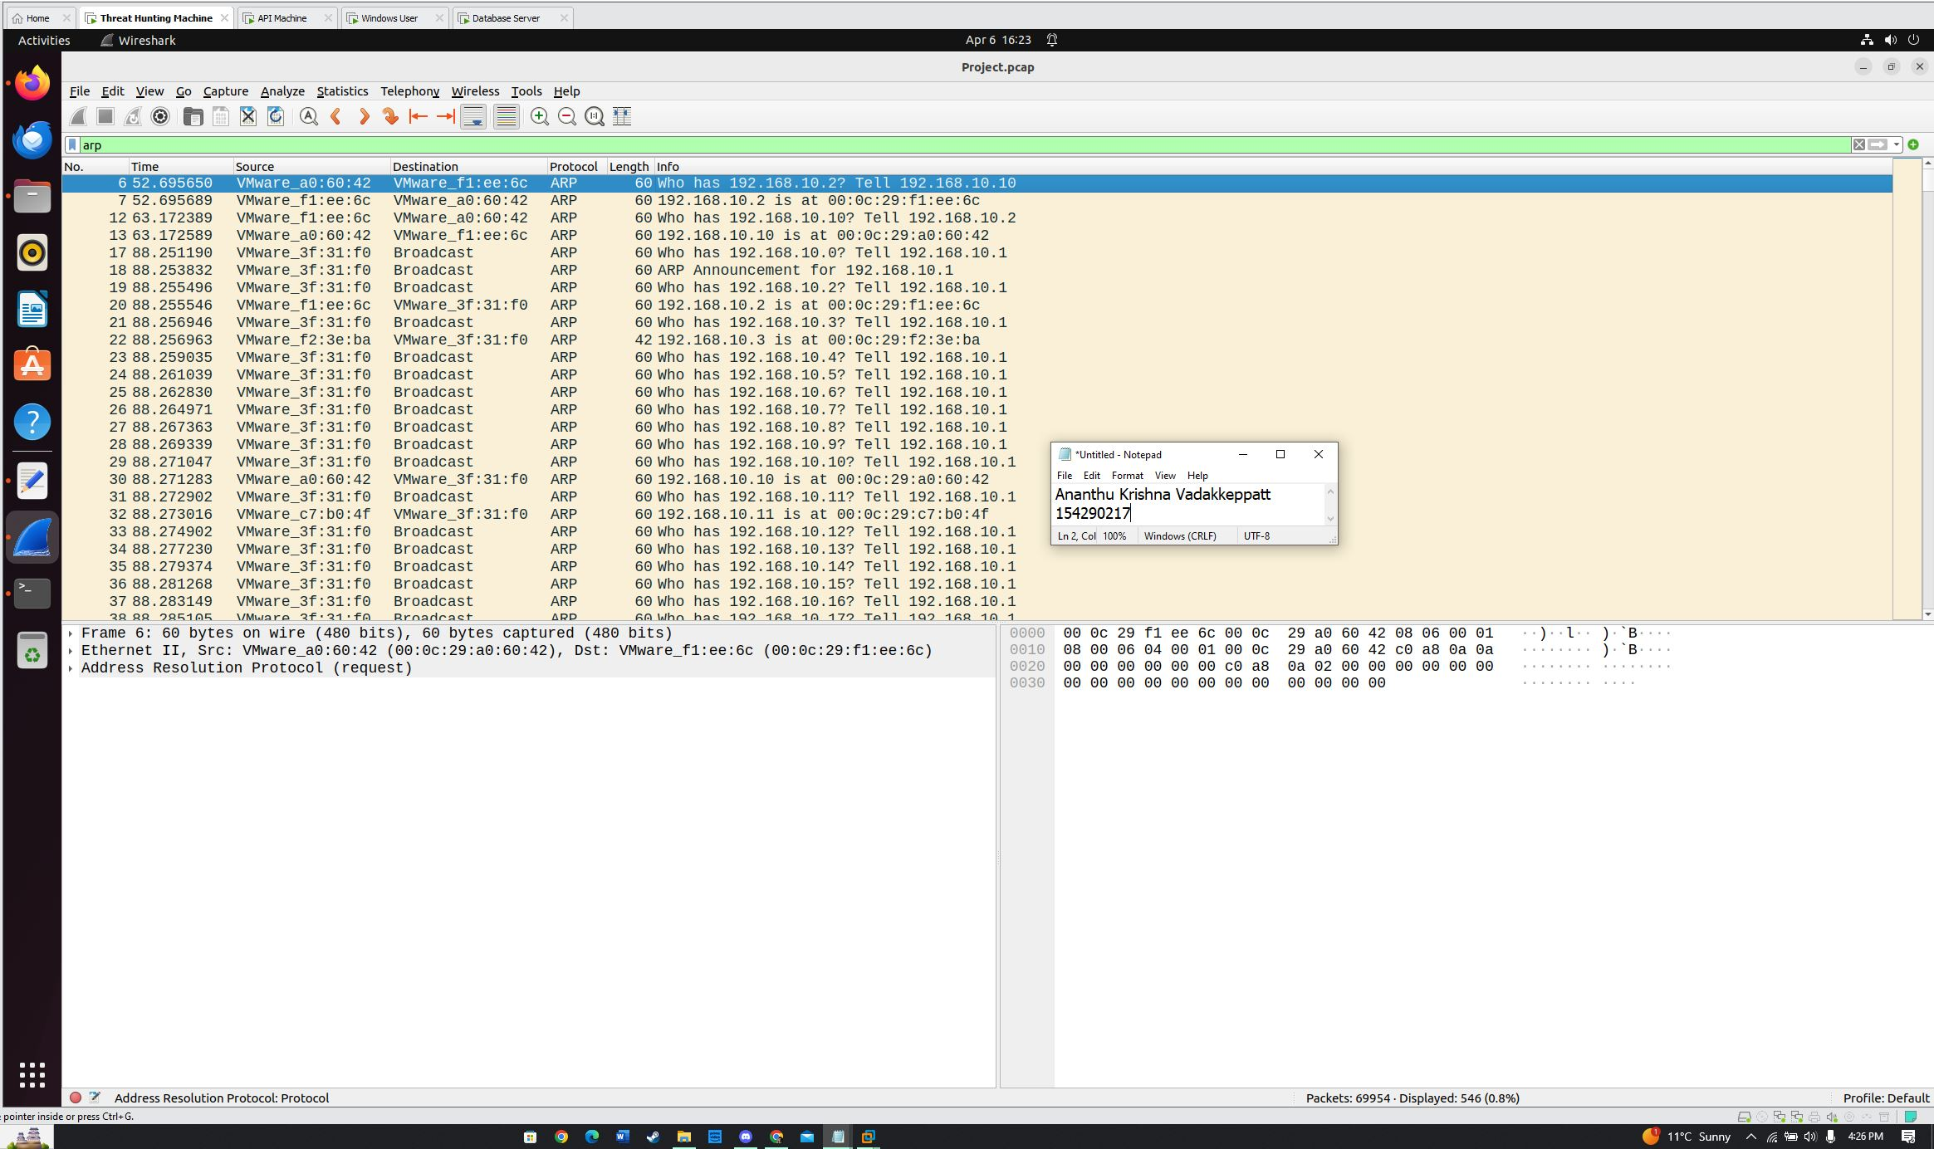
Incident Report Findings

Slide 6
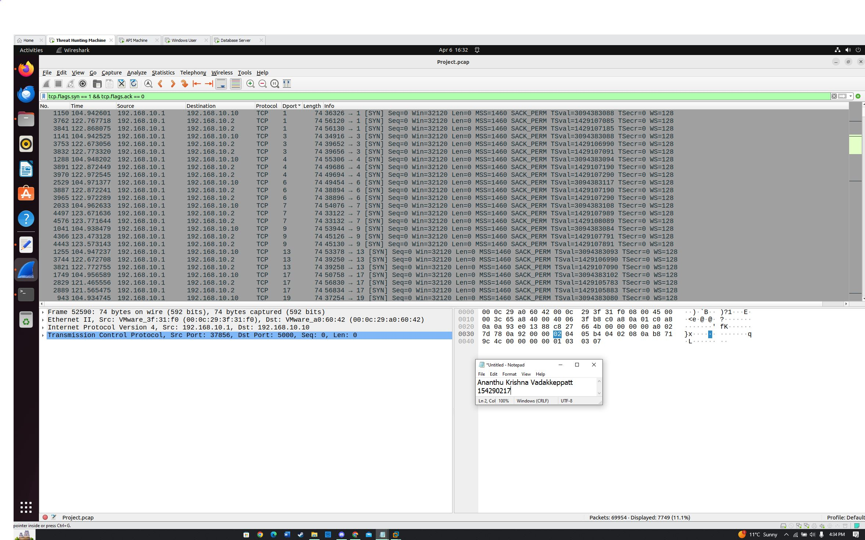

Slide 7
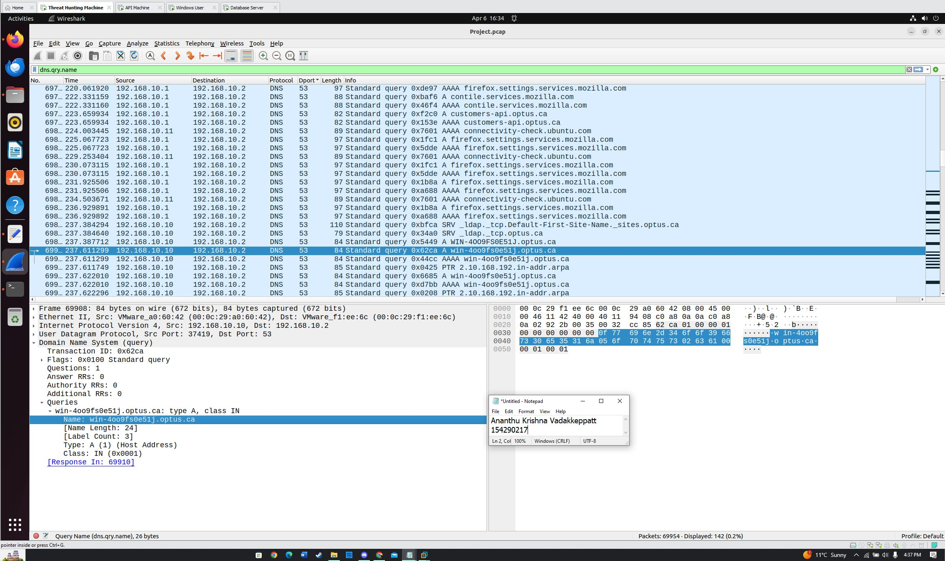

Slide 8
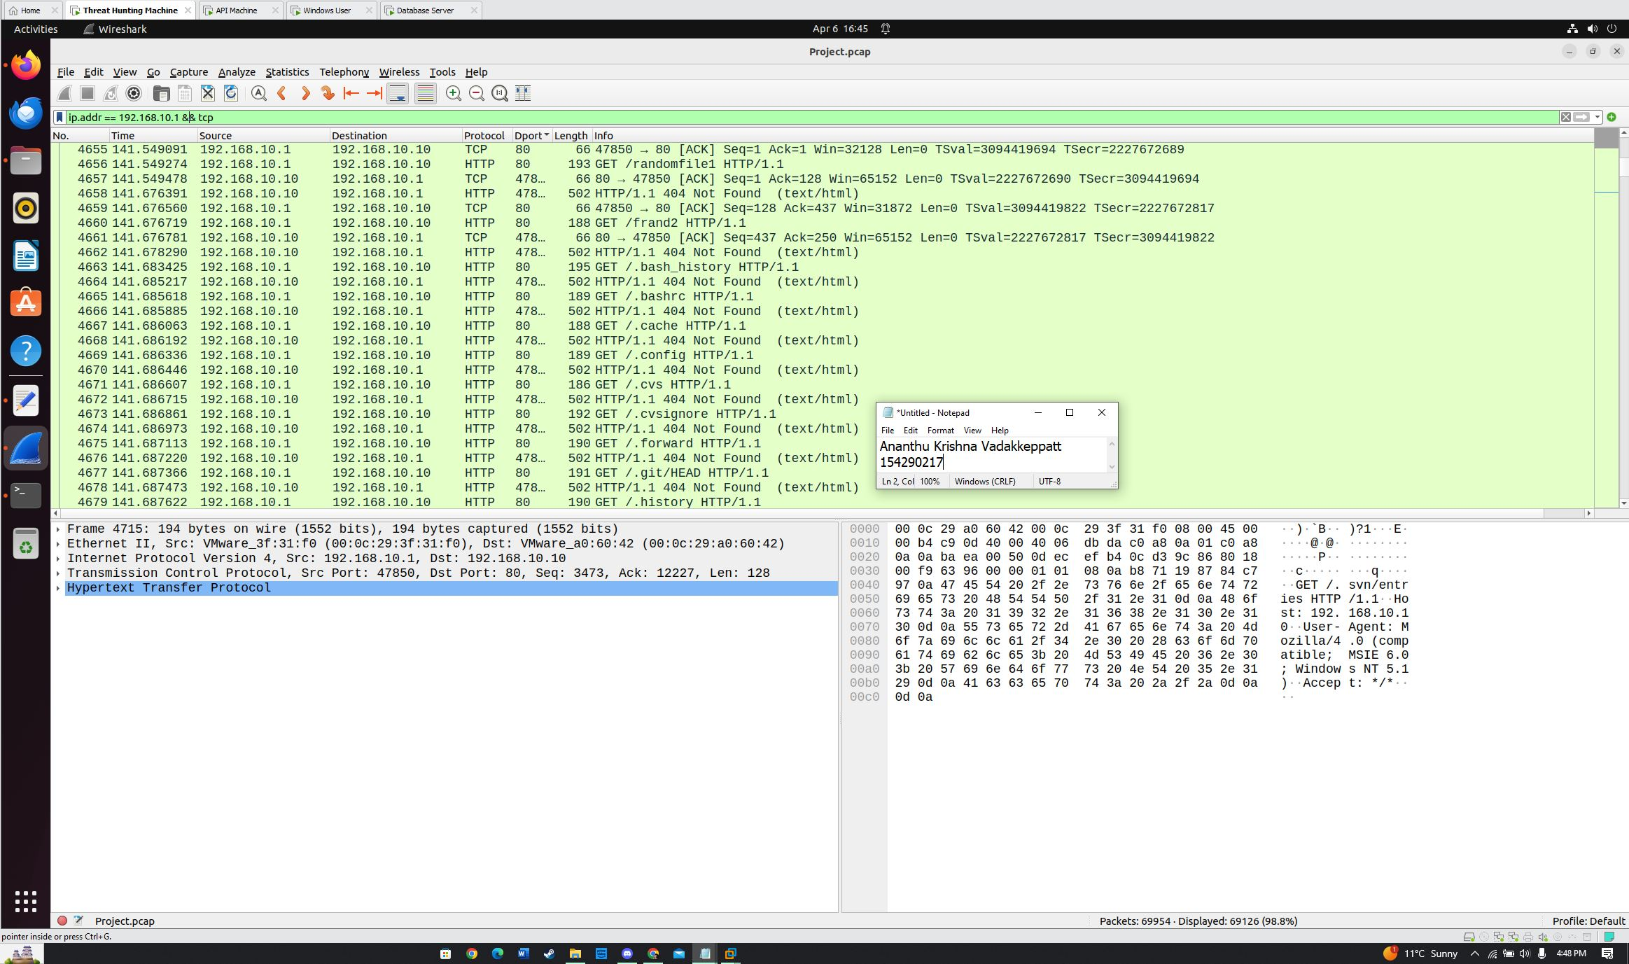

Slide 9
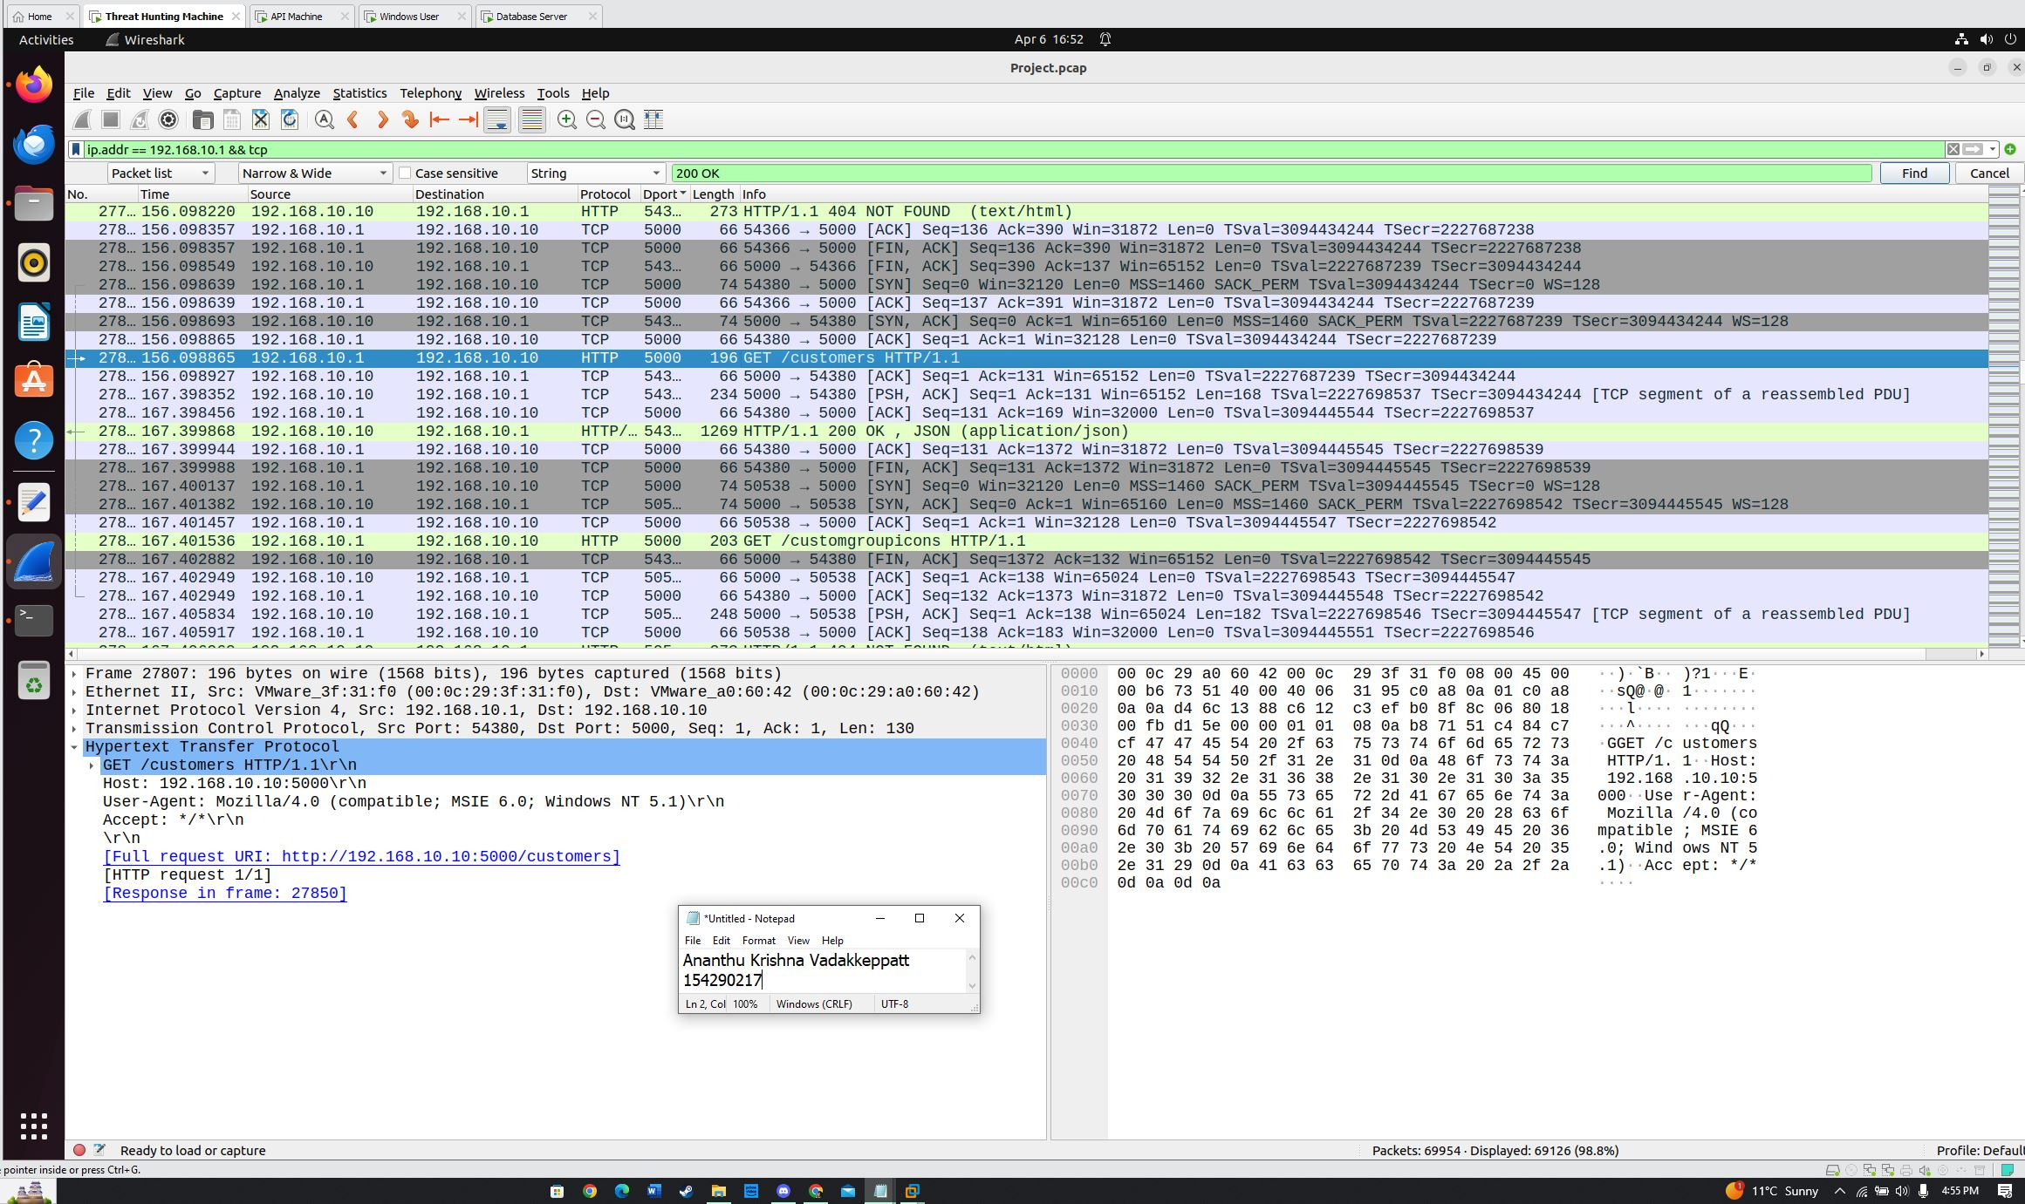

Slide 10
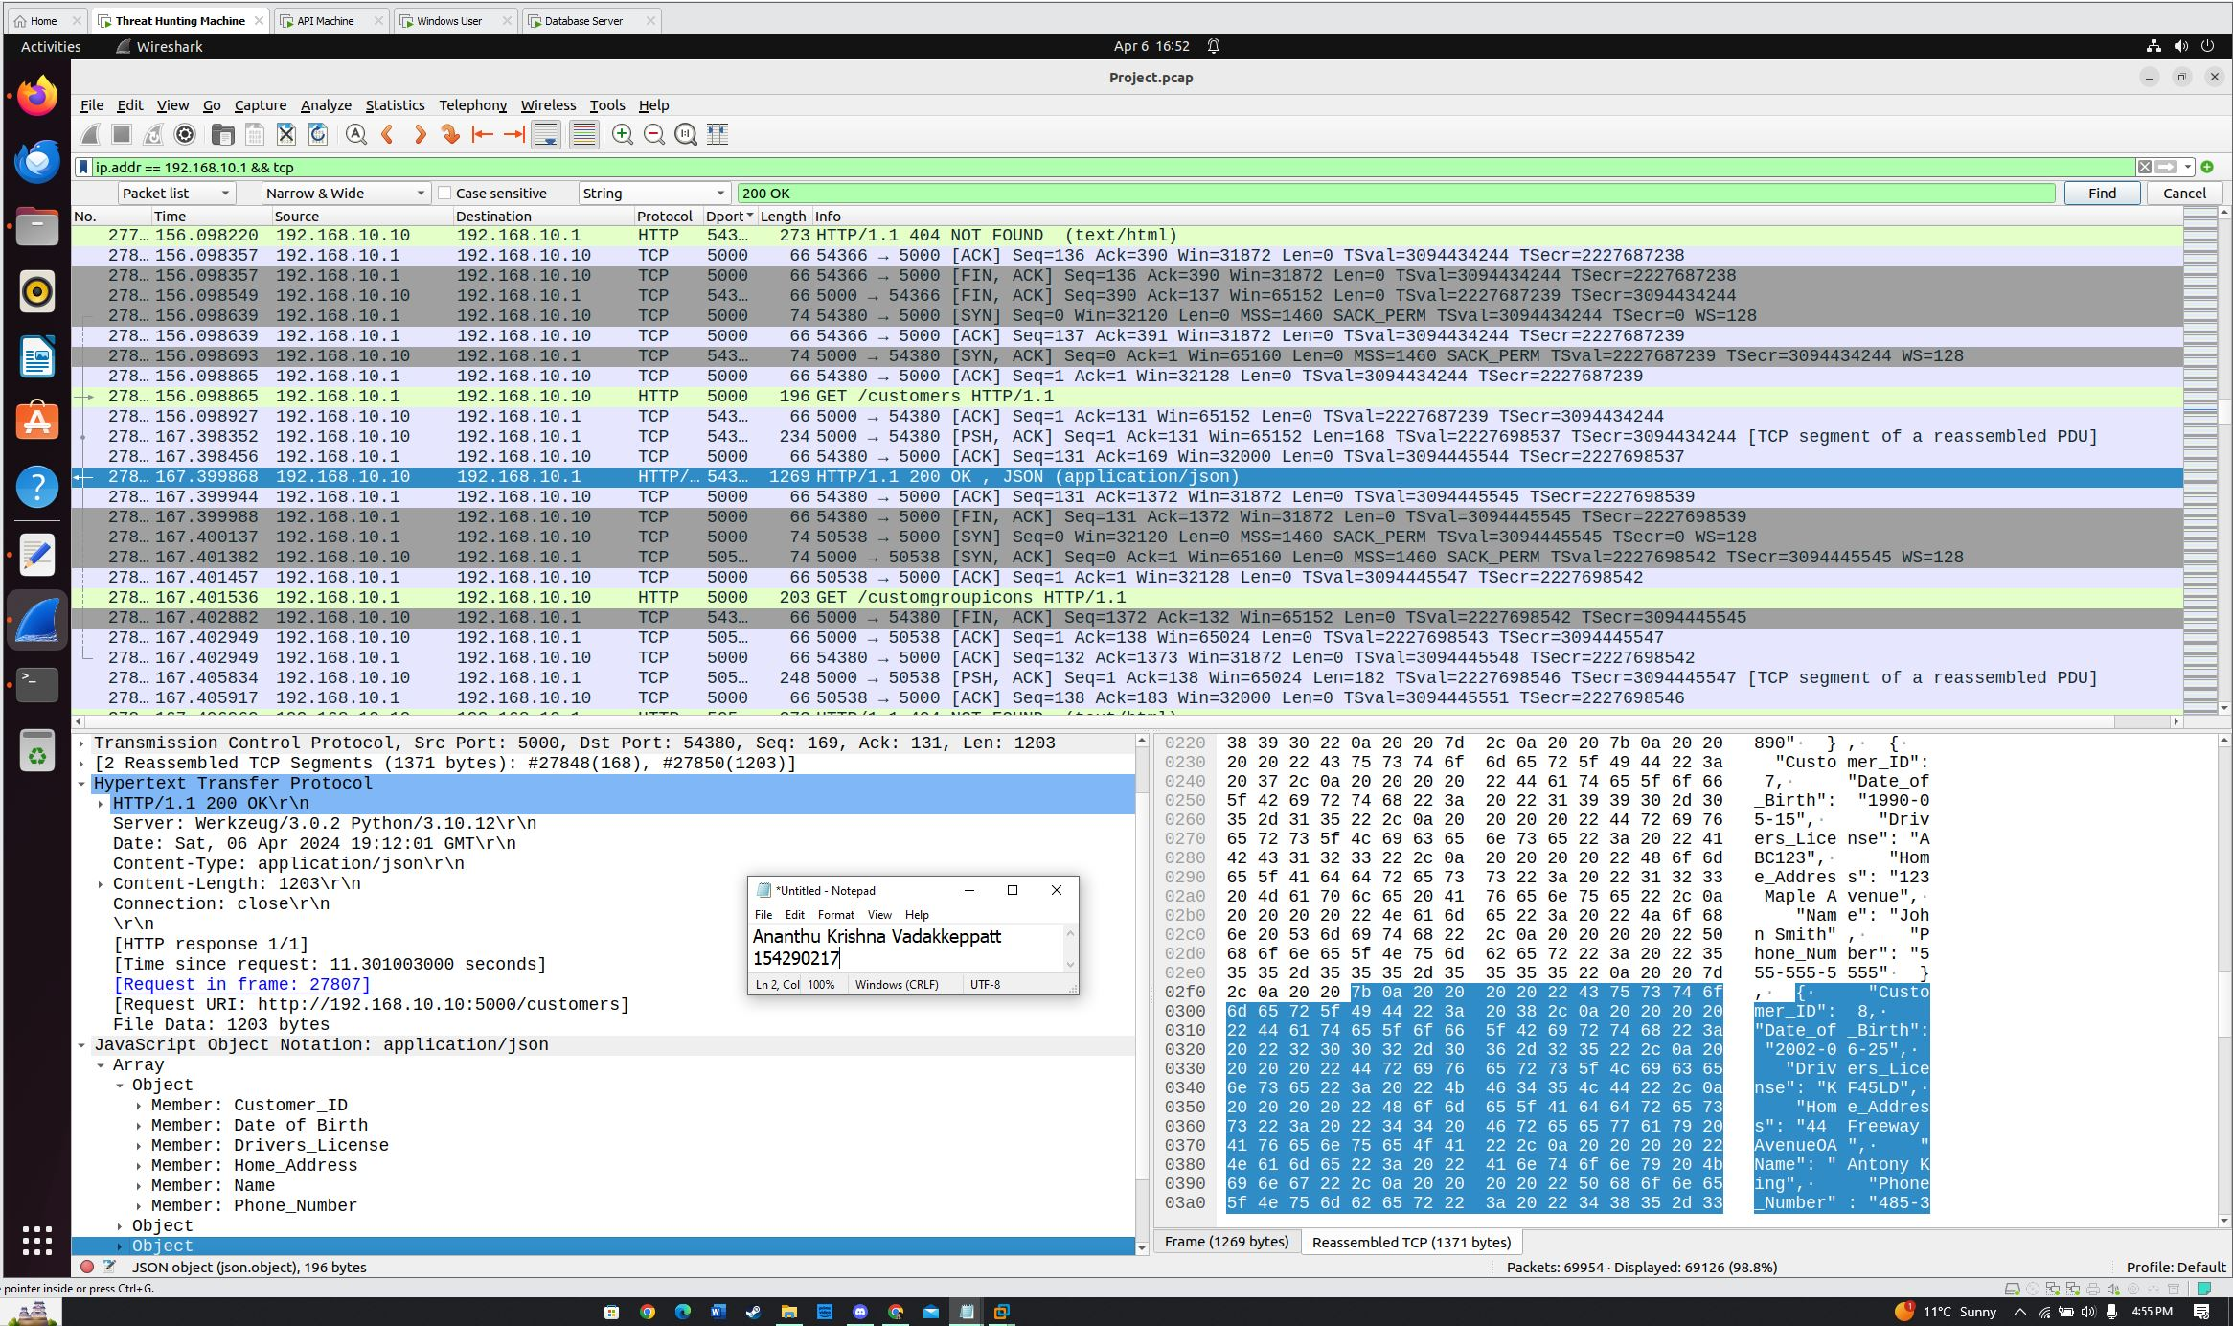

Slide 11
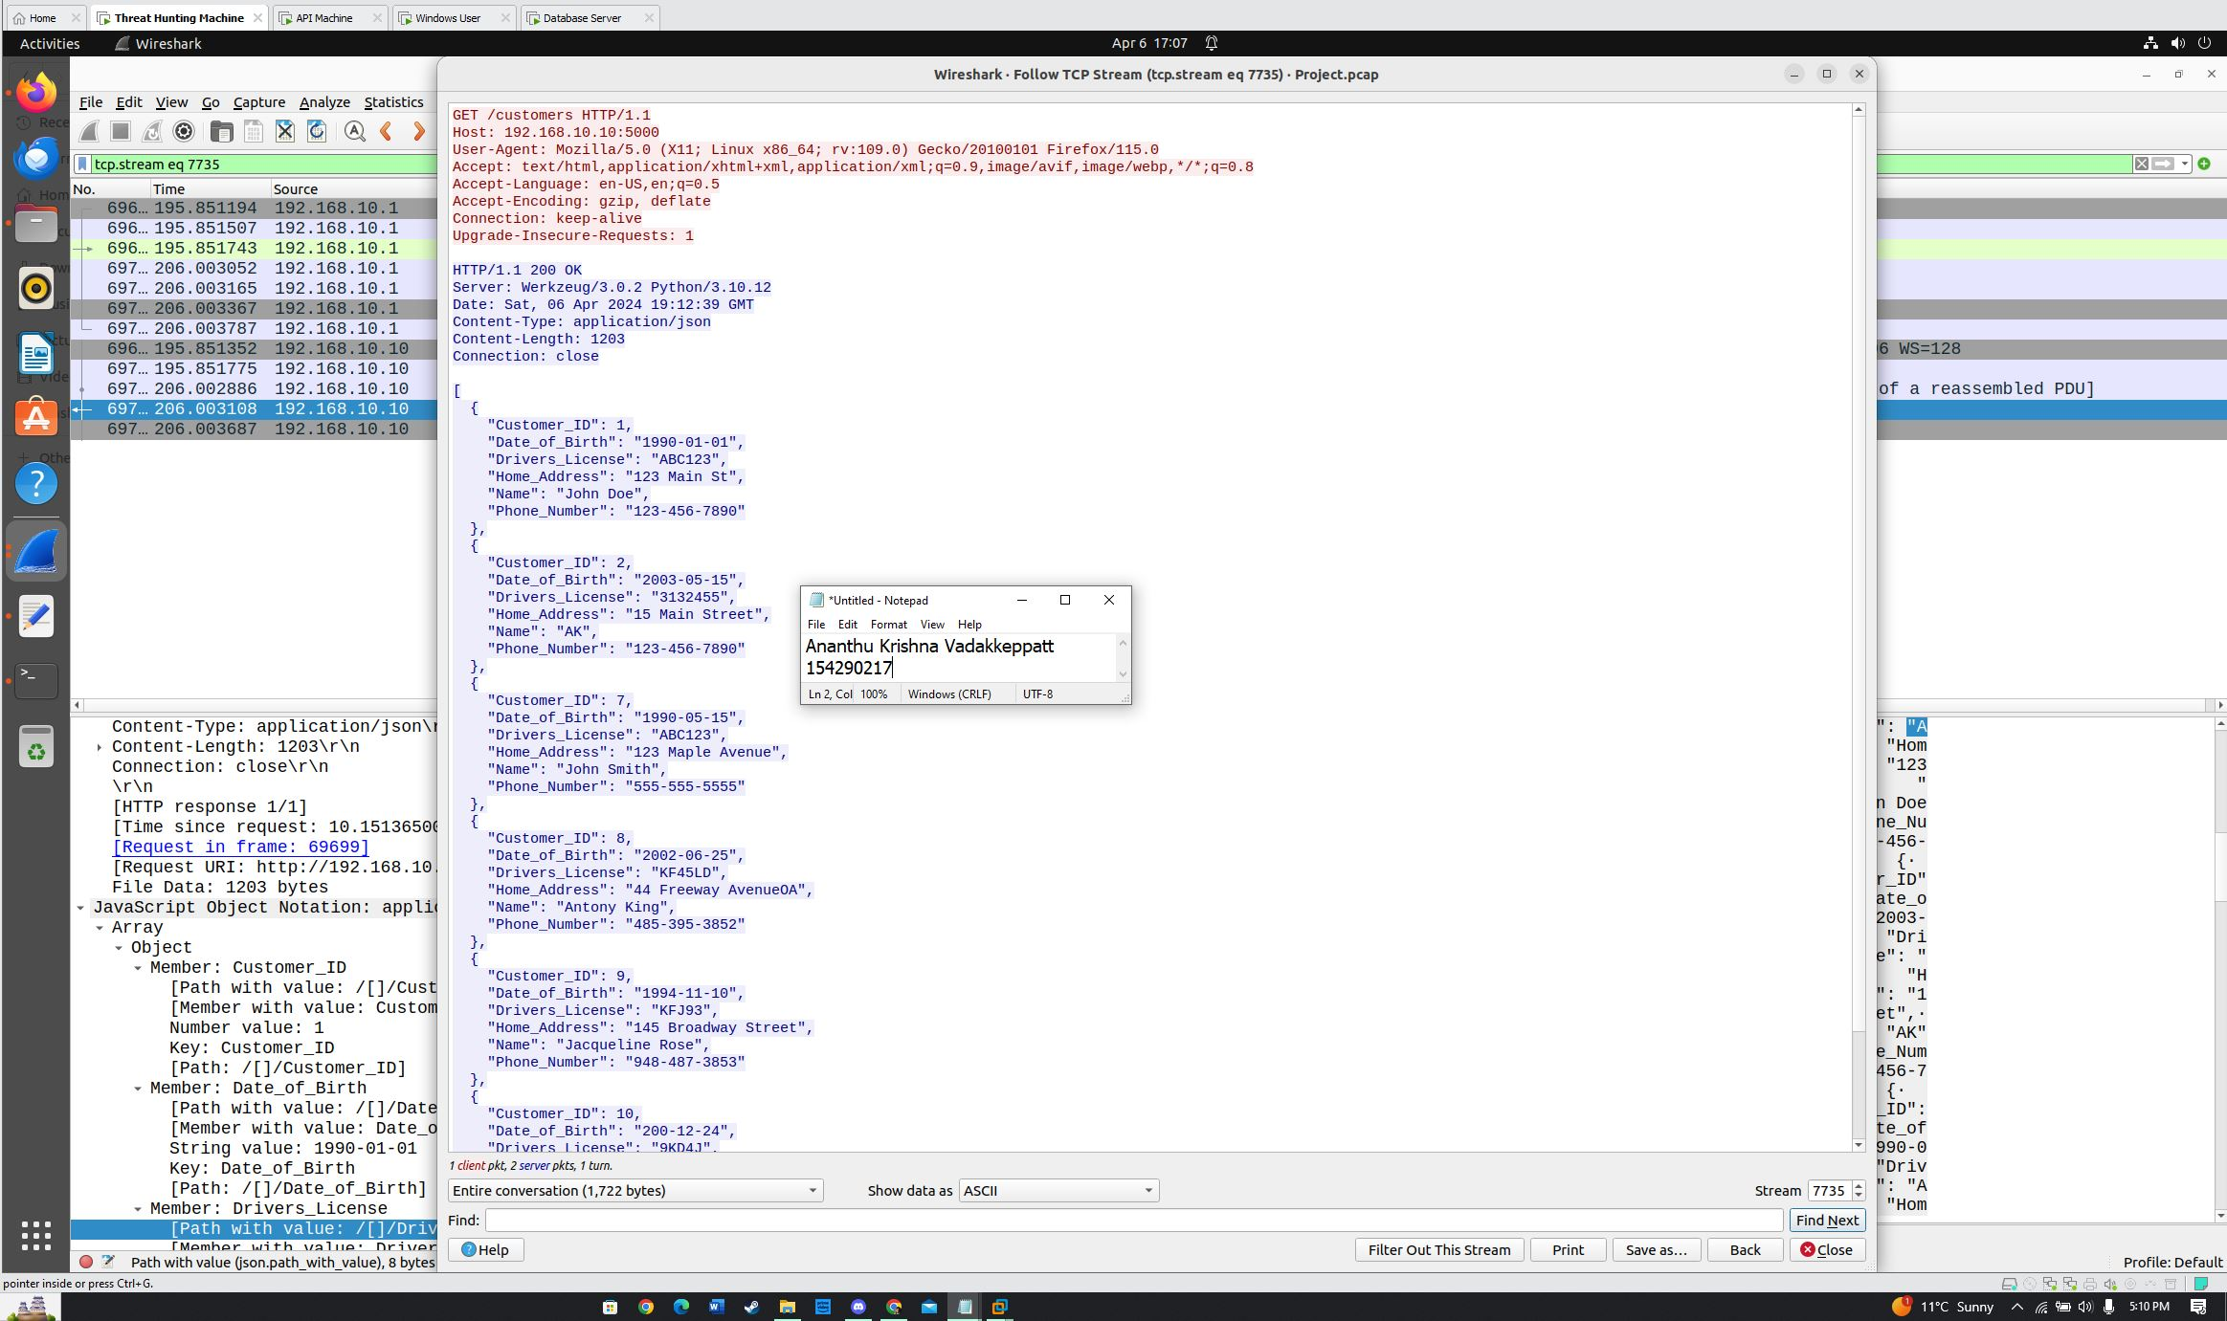

Slide 12
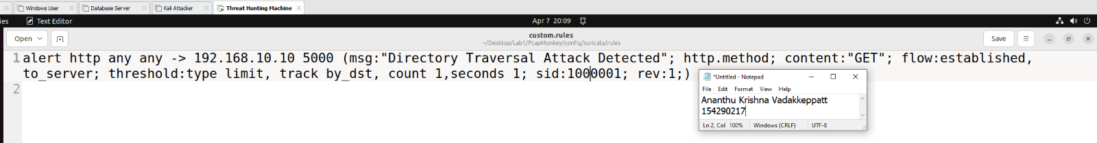
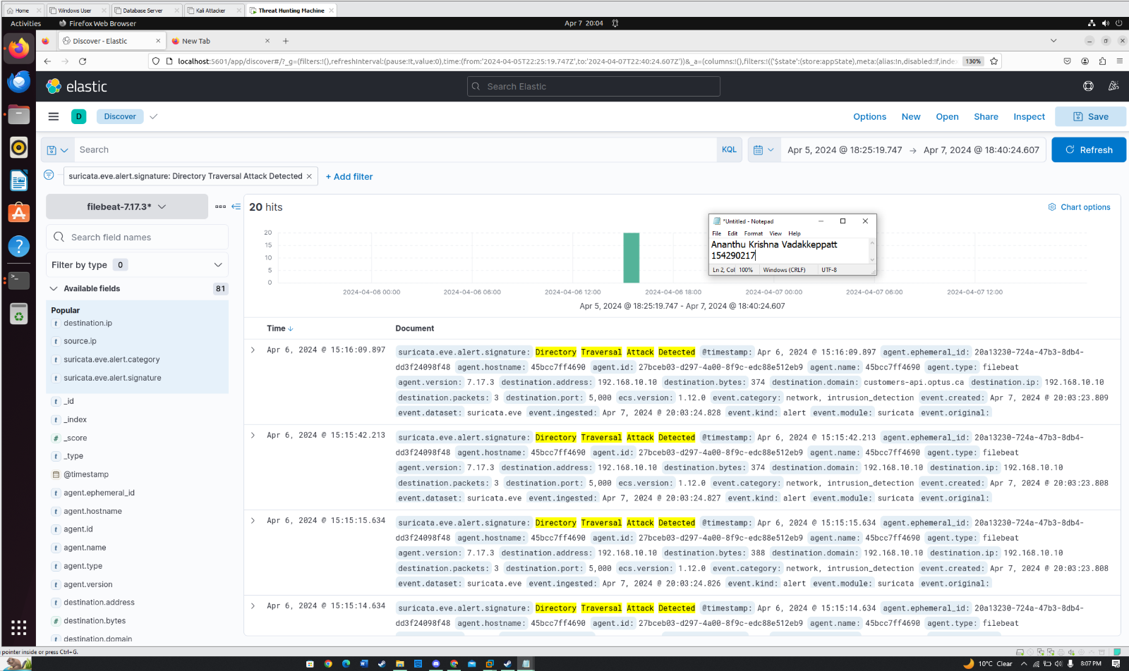

Slide 13
Q&A

